Slide 1



Predicting Human Decision-Making:
Tools of the Trade
Ariel Rosenfeld and Sarit Kraus
Dept. of Computer Science
Bar-Ilan University
Israel

Slide 2
Sarit Kraus
Professor of Computer Science at Bar-Ilan University, Israel and an Adjunct Professor at the University of Maryland.
Focus on Intelligent Agents and Multi-Agent Systems.
Received the EMET Prize, IJCAI ‘Computers and Thought Award’, the ACM SIGART Agents Research award, and the prestigious Advanced ERC Grant.
Published over 300 papers in leading journals
and major conferences.

Slide 3
Ariel Rosenfeld
Currently completing his PhD in Computer Science.
  Seeking a postdoc.
BSc in Computer Science and Economics.
Focus on Human-Agent Interaction.
Published extensively on the topic at top venues such as AAAI, IJCAI, AAMAS and ECAI.
Best Lecturer Award (2017)

Slide 4

AAAI 2017 Tutorial
https://sites.google.com/view/predicting-human-dm
http://tinyurl.com/predicting-human-DM
Slides and all references.

Slide 5
Should have been:
Human-Interacting Agents based on the Predicting Human Decision-Making:
Tools of the Trade
Ariel Rosenfeld and Sarit Kraus
Dept. of Computer Science
Bar-Ilan University
Israel
Notes:
Perhaps tell a story about Arrow…

Slide 6
Agenda
Introduction to human decision making
Normative Prediction
Descriptive Prediction
From Predictions to Actions
Conclusions

Slide 7
Introduction to Human Decision Making
What are exactly are we talking about?

Slide 8

Human Decision-Making
Complex Cognitive process.
A lot of theoretical questions
A lot of practical implications
Should we try and Understand or Predict?

Slide 9
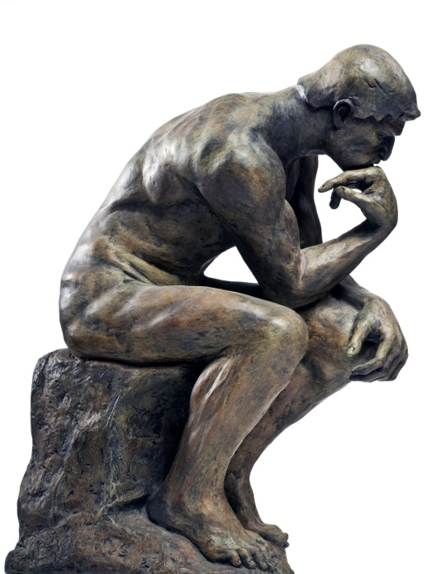
Understanding DM
“…much have been learned about how and why we make decisions… yet, we are still discovering the tip of the iceberg…”
Rorie AE, Newsome WT. A general mechanism for decision-making in the human brain? TRENDS in Cognitive Sciences. 9(2):41-43 (2009).
Gold JI, Shadlen MN. The neural basis of decision making. Annual Reviews in Neuroscience. (30):535-574 (2007).
Feng S, Holmes P, Rorie A, Newsome WT. Can monkeys choose optimally when faced with noisy stimuli and unequal rewards? PLOS Computational Biology. 5(2): (2009).
Kiani R, Shadlen MN. Representation of confidence associated with a decision by neurons in the parietal cortex. Science. 324(5928):759-764 (2009).

Slide 10
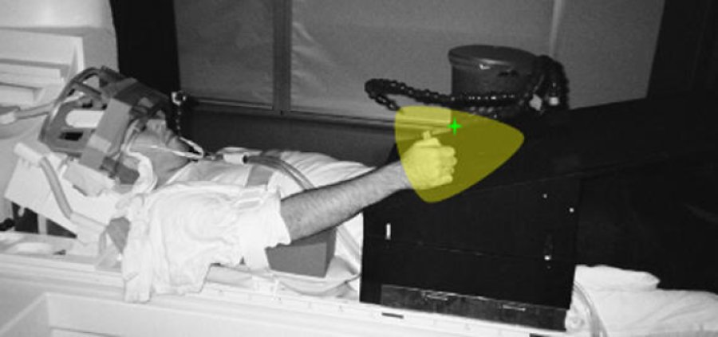
J. P. Gallivan, D. A. McLean, K. F. Valyear, C. E. Pettypiece, J. C. Culham. Decoding Action Intentions from Preparatory Brain Activity in Human Parieto-Frontal Networks. Journal of Neuroscience, 2011;

Slide 11
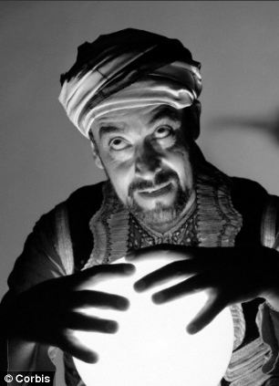
Predicting DM
Easier to validate.
Observable - No intrusive investigation.
Great theoretical and practical benefit
  To CS:
    Enhancing Human Interaction with Software\Robots…
    Training People
    Replacing People
    Supporting People
    …

Slide 12
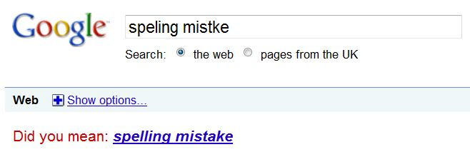

Slide 13
What drives human DM?
Among others…
  Past experience (Juliusson, Karlsson, & Gӓrling, 2005, Sagi, & Friedland, 2007)
  MANY Cognitive biases (e.g., Marsh, & Hanlon, 2007; Nestler. & von Collani, 2008; Stanovich & West, 2008; West et al., 2008, Epley, & Gilovich, 2006).
  Individual differences such as Age, cognitive abilities, gender… (de Bruin, Parker, & Fischoff, 2007; Finucane, Mertz, Slovic, & Schmidt, 2005, Reed, Mikels, & Simon, 2008)
  Decision Complexity (Goldstein & Gigerenzer, 2002; Hilbig & Pohl, 2008)
  Social aspects (Acevedo and Krueger , 2004).

Slide 14
Role of the prediction agent
Cooperative
Adversarial
Partially Conflicting

Slide 15
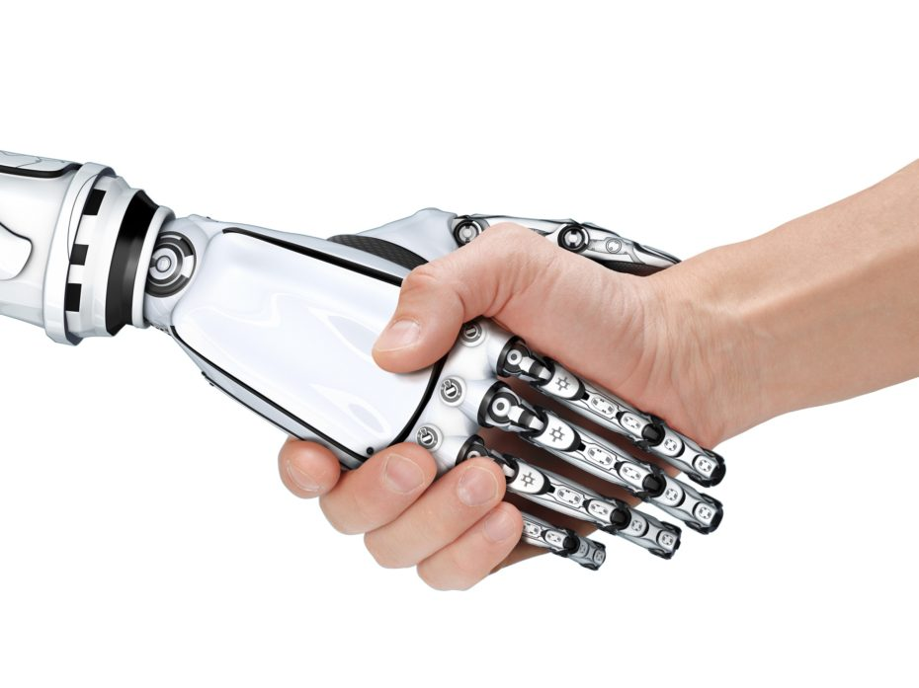
Cooperative prediction agents
The agent only cares about the human benefit.
“Teammates”.
E.g., Rehabilitation, Automated Assistant.

Slide 16
Example: Robot Assistant
Needs to anticipate what the person’s next action will be and act accordingly
  bring the needed pieces\tools…
  Movie – Robotic Assistant (Cornell)
Anticipating Human Activities using Object Affordances for Reactive Robotic Response, Hema S Koppula, Ashutosh Saxena. Robotics: Science and Systems (RSS), 2013.
Learning Spatio-Temporal Structure from RGB-D Videos for Human Activity Detection and Anticipation, Hema S Koppula, Ashutosh Saxena. International Conference on Machine Learning (ICML), 2013.
Improved Human-Robot Team Performance Using Chaski, A Human-Inspired Plan Execution System, Shan et al. 2011

Slide 17

Adversarial prediction agents
The agent’s success means worse outcomes for the person.
E.g., game playing.

Slide 18
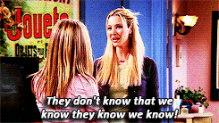

Example: Poker
Carmel and Markovitch (1993) were the first to try to automatically learn a model of the opponent’s move selection progress.
Opponent modeling is a strong buzz-word in games.
2017: Carnegie Mellon University's Libratus just won a 20-day tournament against the world champs of Texas Hold'em (Noam Brown and Tuomas Sandholm)
[but did not use prediction]
http://www.techrepublic.com/article/ai-just-beat-the-worlds-4-best-poker-players-what-it-means/
https://www.youtube.com/watch?v=JtyA2aUj4WI
Revell, Timothy. "AI takes on top poker players." (2017):

Slide 19
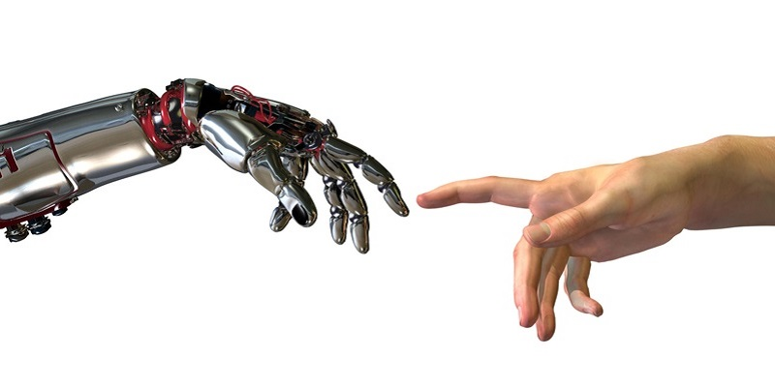
Partially Conflicting Interests
The agent is interested in A, which partially conflicts with the human interest, B.
E.g, negotiation.

Slide 20


Example: Economical Recommender Systems
“Buy this book, you will like it!”
  (AND it will make us more money than the other options…)
Shani, Guy, David Heckerman, and Ronen I. Brafman. "An MDP-based recommender system." Journal of Machine Learning Research 6.Sep (2005): 1265-1295.‏

Slide 21
Physical vs. Software
Vast impact on:
  Perception
  Actions
  Usability
  Etc.

Slide 22

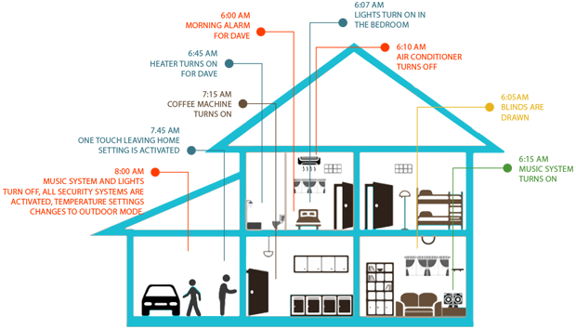
Active Actor vs. Observer
Sensing and recording
  e.g., Activity loggers.
Takes Action
  E.g., smart home.
Modeling and Understanding Human Routine Behavior, Banovic et al. (2016)
Cook, Diane J. "How smart is your home?." Science (2012)‏
Notes:
לדוגמה בבית חכם משתמשים בחיצוני כדי לזהות פעולות שקורות במקומות מסוימים
נגיד אם פתח את המקרר ואז ישב בשולחן כנראה שהוא אוכל,
אם הוא נמצא ליד הכיור כנראה שהוא עושה כלים וכו'
שום דבר לא יכול להיות ידוע אם הוא יצא מהטווח של החיישנים
מתאים בעיקר לשמירה(לא ניתן לשים חיישנים על הפורץ)
דוגמה טובה לחיישנים אלה וזיהוי וידאו זה קינקט
יש כמה בעיות עם גישה זאת פרטיות, התפשטות(קשה לקלוט את כל הגוף של האדם תמיד) וסיבוכיות(מבחינת מחשב).
כל זה נותן מוטיבציה להשתמש בחיישנים לבישים, כל החיישנים הם פר משתמש והמידע מחולק לפי חלוקת זמן

Slide 23
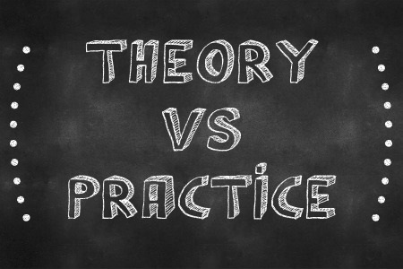
Are People Predictable?
Normative
  Theory-Driven
Descriptive
  Data-Driven
Notes:
When we are talking about prediction we can consider two approches –
The first is to use theory. Namely, we can make some assumption on human behaviour and predict people’s decisions accordingly.?
The most prominent and well studied option in this realm is the rationality assumption. One can assume people are rational actors and therefor their desions are perdictable to some extent.
But are people really rational?
And if not, can we use another normative modeling and describe their behaviour?
We’ll adressed this question in a second.
The second option is to use statistics and machine learning teq. For predicting DM. But as we all know people are very different from one another which poses a great challenge.
So lets first examine the first option.

Slide 24
Normative Prediction
Using normative rules, extracted from behavioral sciences.

Slide 25
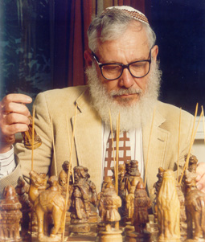
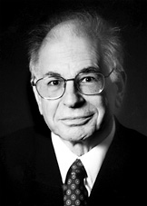
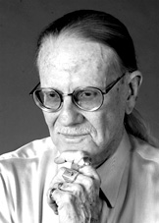
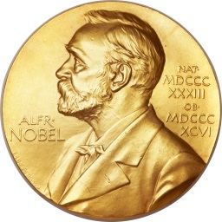
Are People Rational?
2002
Daniel Kahneman
Vernon Smith
Israel Aumann
Notes:
Are people really rational?
Well Vernon Smith got a nobel prize proving they are and Tverskey got a nobel prize for proving they are not. So which is it?
Israel Auman explained this conflict by saying that people are rational in their DM procedures but not in the individual desions. Namely, the rule that people apply is usually the right one, but not necceseraly the right one for a specific context.
Let’s try it ourselves.

Slide 26
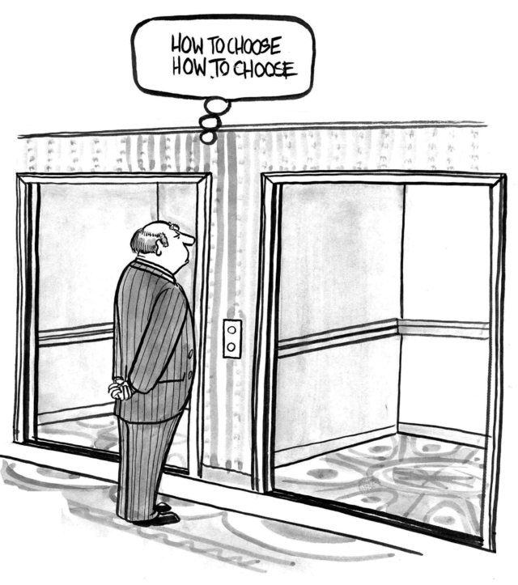
Let’s try it ourselves!
Answer the question
on your sheet.
Notes:
…
The rational thing is to buy another one.
If watching the movie worths more than the cost (5$), then the whole ticket\money-in-the-gutters incid should not have any effect.

Slide 27
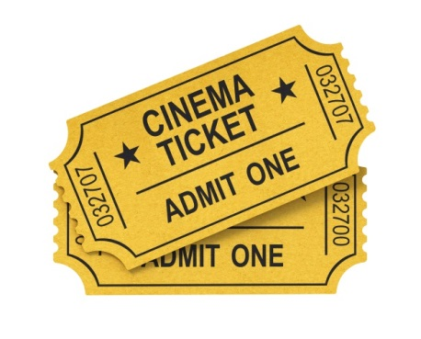
What happened here?
You wish to see the new StarWars movie. A ticket costs 5$.
What if -
You go to the box office and once you open your wallet and take a 5$ bill out the winds blows it away into the gutters.
A few moments after purchasing the ticket the wind blows the ticket out of your hands and into the gutters.
Would you buy a ticket?
Notes:
…
The rational thing is to buy another one.
If watching the movie worths more than the cost (5$), then the whole ticket\money-in-the-gutters incid should not have any effect.

Slide 28
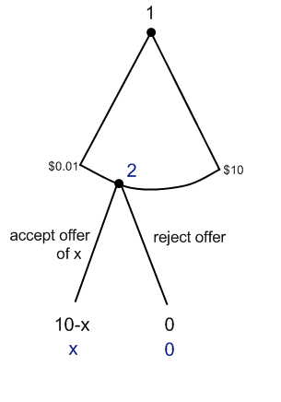
Two Decision Makers
The Ultimatum game

Slide 29
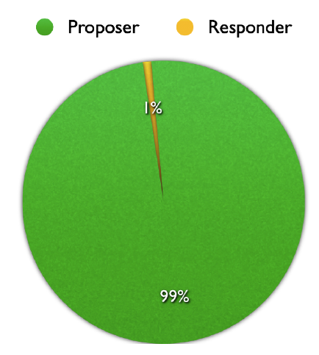
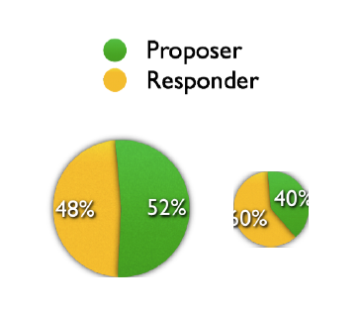
Notes:
Culture sensetive
Social values
Shame
Interaction – allowed to talk or not.
Many things that should be irrelevant…

Slide 30
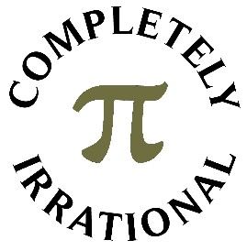
What are we missing?
Irrationalities attributed to
  sensitivity to context
  lack of knowledge of own preferences
  the effects of complexity
  the interplay between emotion and cognition
  the problem of self control
  Etc.

Slide 31
Irrationality
Kahneman and Tversky (1979) identified the most important deviations from the assumption that people maximize expected return.
Prospect theory (extended to cumulative prospect theory), 1992
Reflection effect.
Overweighting of rare events.
Loss aversion.

Slide 32
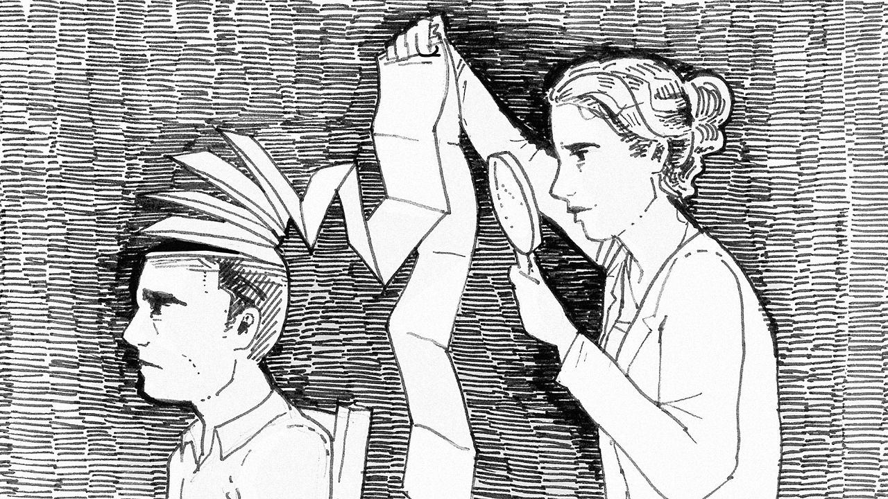

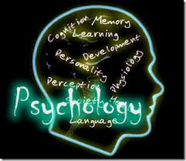
Irrationally Predictable?
To a certain extent – YES!
Behavioral sciences provide empirical observations and explanatory theories.
Most models specify general criteria that are context sensitive but usually do not provide specific parameters or mathematical definitions.

Slide 33
Irrationally Predictable?
To a certain extent – NO!
So why not extend the behavioral models?
Extending classic normative models such as the Prospect Theory requires additional non-trivial assumptions and/or parameters. (Rieger & Wang, 2006; Tversky & Bar-Hillel, 1983; Tversky & Fox, 1995; Wakker, 2010, Blavatskyy, 2005, Thaler and Johnson 1990, Payne 2005, Birnbaum 2008).

Slide 34
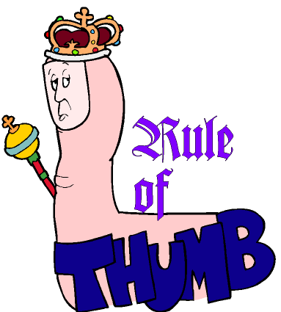
Heuristics
Rules of thumb.
Simple heuristics can explain some of the anomalies that motivated the development of normative approaches in the first place (Brandstätter, Gigerenzer, and Hertwig, 2006).
  E.g., the get-something effect (where people prefer lotteries where values greater than zero are guaranteed) can be easily explained by a simple heuristic (e.g., Venkatraman, Payne, & Huettel, 2014).

Slide 35
Heuristics
Heuristics serve as a framework in which satisfactory decisions are made quickly and with ease (Shah & Oppenheimer, 2008).
In various cases, produce the optimal results (Nokes &Hacker, 2007).

Slide 36
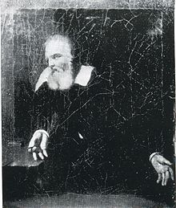
Albeit it does move
Despite the popularization of
Machine Learning approaches…
Decision Theory
Game theory
Psychological models
Heuristics
Galileo Galilei

Slide 37
Decision Theory (reminder)
(How to make decisions)
Decision Theory =
Probability theory + Utility Theory
  (deals with chance) (deals with outcomes)
Fundamental idea
  The MEU (Maximum expected utility) principle
  Weigh the utility of each outcome by the probability that it occurs

Slide 38
Basic Principle
Given probability P(out₁| A_{i}), utility U(out₁),
P(out₂| A_{i}), utility U(out₂)…
Expected utility of an action A_{i}i:
EU(A_{i}) = Σ U(out_{j})*P(out_{j}|A_{i})
Choose A_{i} such that maximizes EU
MEU = argmax Σ U(out_{j})*P(out_{j}|A_{i})
A_{i} ∈ Ac Out_{j} ∈ OUT
Out_{j} ∈ OUT

Slide 39
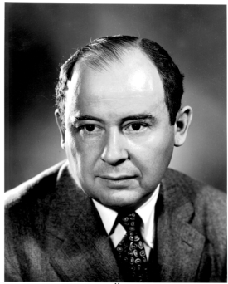
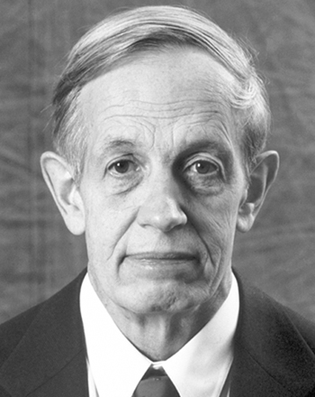
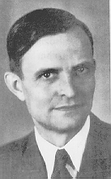
Game Theory
Game Theory by Michael Maschler, Eilon Solan, and Shmuel Zamir. Cambridge. 2013.
The mathematical theory of interaction between self-interested agents (“players”).
Each player must consider how each other player will act in order to make its optimal choice: hence strategic considerations
If a system has a single designer/owner, then game theoretic analysis is probably inappropriate
Heinrich Freiherr
von Stackelberg
John von Neumann
John Nash

Slide 40
Example
Trump and Clinton meet in a presidential debate
They must each choose between debating issues or making insults.
What should Clinton do. . . ?
How well she is perceived to do will depend in part on the choice Trump makes…
What are the possible outcomes here? How do the candidates rank them?

Slide 41
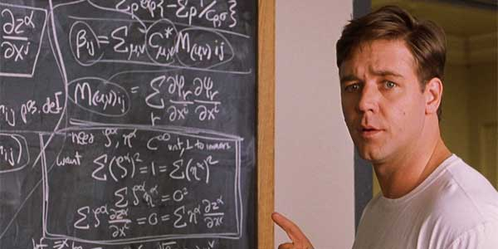
Nash Equilibrium
A strategy profile is a list (s₁, s₂, …, s_{n}) of the strategies each player is using
If each strategy is a best response given the other strategies in the profile, the profile is a Nash equilibrium
Why is this important?
  If we assume players are rational, they will play Nash strategies
  Even less-than-rational play will often converge to Nash in repeated settings.

Slide 42


Pure Nash Equilibrium
Issues
Insults
Issues
0,0
-2,+2
Insults
+2,-2
+1, -1

Slide 43
Mixed Nash Equilibrium
Issues
Insults
Issues
-1,+1
+1,-1
Insults
+1,-1
-1, +1

Slide 44
Exercise
https://www.youtube.com/watch?v=x5Q6-wMx-K8
Movie - Rock Paper Scissors Lizard Spock.

Slide 45
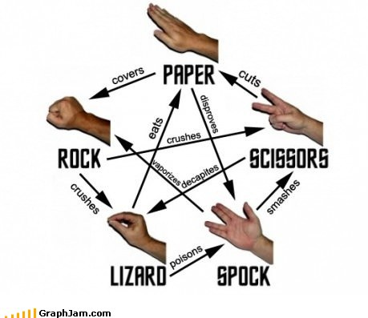
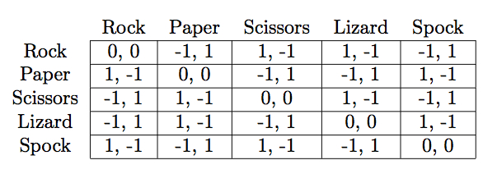

Slide 46
Extensive Form Game
Nuke
- 100, - 100
Kennedy
Arm
Khrushchev
Fold
10, -10
-1, 1
Retract
Pure strategy Nash equilibria: (Arm, Fold) and (Retract, Nuke)

Slide 47
Example: Cuban Missile Crisis
Nuke
- 100, - 100
Kennedy
Arm
Khrushchev
Fold
10, -10
-1, 1
Retract
Pure strategy Nash equilibria: (Arm, Fold) and (Retract, Nuke)
Pure strategy subgame perfect equilibria: (Arm, Fold)
Conclusion: Kennedy’s Nuke threat was not credible.

Slide 48
Subgame perfect equilibrium & credible threats
Subgame perfect equilibrium
  Strategy profile that is in Nash equilibrium in every proper subgame (including the root), whether or not that subgame is reached along the equilibrium path of play

Slide 49
Does GT REALLY work?
In SOME cases where*:
Social norms don’t play (e.g., when incentives are sufficiently large, then they can override norms).
The game is sufficiently simple.
Sufficient experience (e.g., opportunity for trial-and-error learning).
* Ken Binmore, Does Game Theory Work?, MIT Press, 2007.

Slide 50
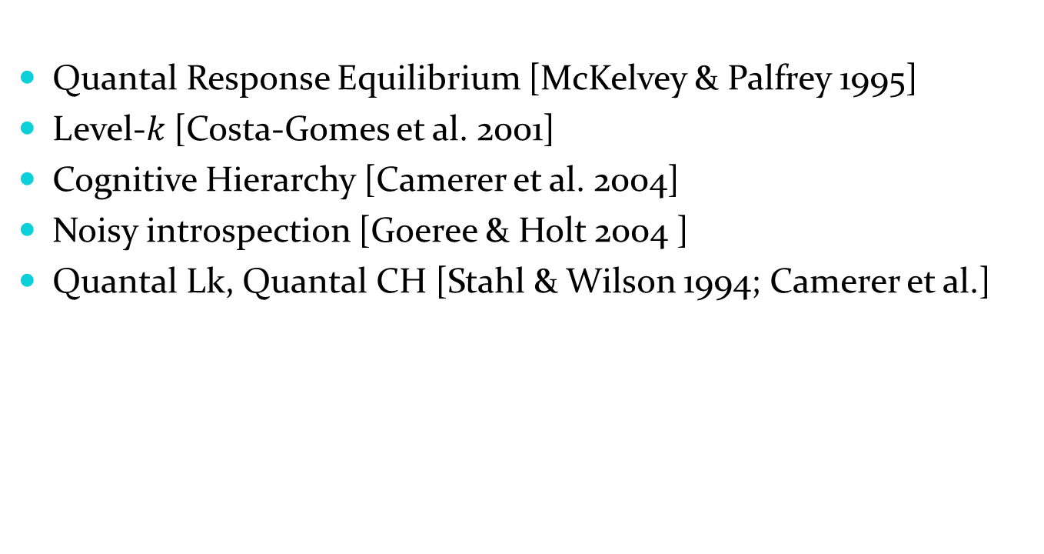
Other models that we won’t go over…
Quantal Response Equilibrium [McKelvey & Palfrey 1995]
Level-$k$ [Costa-Gomes et al. 2001]
Cognitive Hierarchy [Camerer et al. 2004]
Noisy introspection [Goeree & Holt 2004 ]
Quantal Lk, Quantal CH [Stahl & Wilson 1994; Camerer et al.]

Slide 51
Normative Prediction Use Cases
Security Games
Negotiation
Training People
Shopping Agents

Slide 52
Security Games
A major success story!

Slide 53
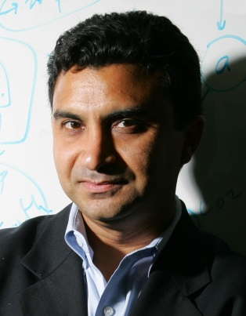
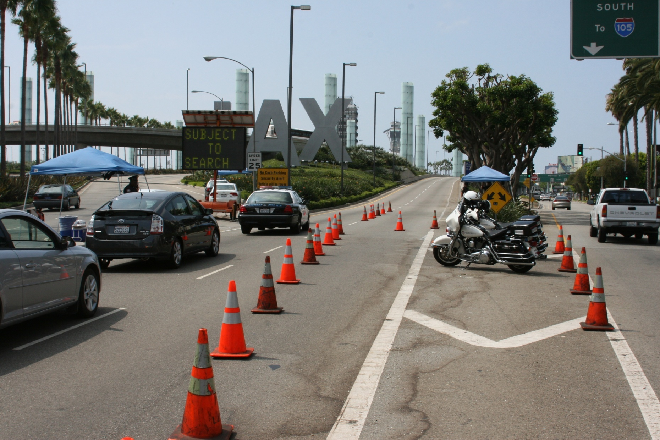
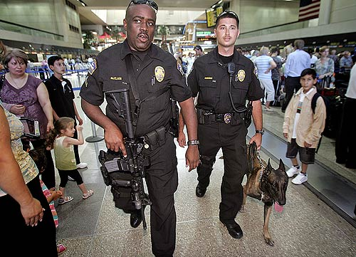
LAX Airport Case
Milind Tambe
Eight Inbound Roads, Eight Terminals: Limited Staff, Canines
Where and when to set up checkpoints?
Where and when to do canine patrols?
Pita, James, et al. "Deployed ARMOR protection: the application of a game theoretic model for security at the Los Angeles International Airport.“, 2008.‏
Notes:
From protection of infrastructure to wildlife, security remains a global concern.
Unfortunately we have limited resources and we have to optimize their use. We hence appeal to game theory for security resource optimization…

Slide 54
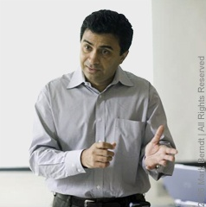

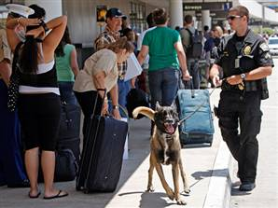
ARMOR: Deployed at LAX 2007
“Assistant for Randomized Monitoring Over Routes”
  Problem 1: Schedule vehicle checkpoints
  Problem 2: Schedule canine patrols
Randomized schedule: (i) target weights; (ii) surveillance
ARMOR-Checkpoints
ARMOR-K9

Slide 55


Stackelberg security games (SSGs): defender vs adversary
Defender’s optimal randomized strategy
Adversary
 | Terminal #1 | Terminal #2
Terminal #1 | 5, -3 | -1, 1
Terminal #2 | -5, 5 | 2, -1
Police
Notes:
P=3/13 ; q=3/5

Slide 56
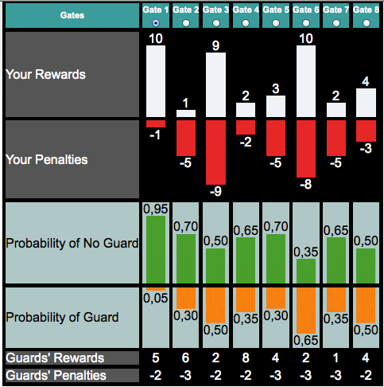
LAX Based Game
Stackelberg security games
  Defender (rational)
    Commit to a strategy first
  Adversary (bounded rational)
    Observe defender’s strategy
    Attack one of targets
Game Interface
Notes:
In SSGs, there is a rational defender attempting to optimally allocate her limited resources to protect a set of important targets and an adversary who tries to attack one of such targets. The key assumption of SSGs is that the defender has to commit to a strategy first and the adversary can observe that strategy and make his decision of attacking based on his observation. In this study, the adversary will respond non-optimally or boundedly-rational.
The SSGs can be represented as the follows: The payoffs for the defender and adversary depends on which target is attacked and whether that target is protected by the defender or not. For example, if the adversary attacks target t, he will receive a reward R_t^a if the defender is not protecting that target, otherwise, he will receive a penalty P_t^a. Conversely, the defender will receive a penalty P_t^d in the formal case and a reward R_t^d in the latter case.
In our experimental settings, we assume that the adversary has the full observation about the defender strategy. Specifically, each human subject who act as an adversary in our experiments can observe the security game as shown in the figure on the right hand side. Thus, in each game, the adversary can observe the defender’s strategy in terms of her coverage probability at each target, the reward and penalty of both the defender and the adversary. The adversary will make decision of which target to attack based on this observation. For example, as shown in the figure, the defender’s coverage probability at target 8 is 50%. If the adversary attacks this target, he will receive a reward 4 points if the defender is not protecting this target, otherwise, he will receive a penalty -3.

Slide 57
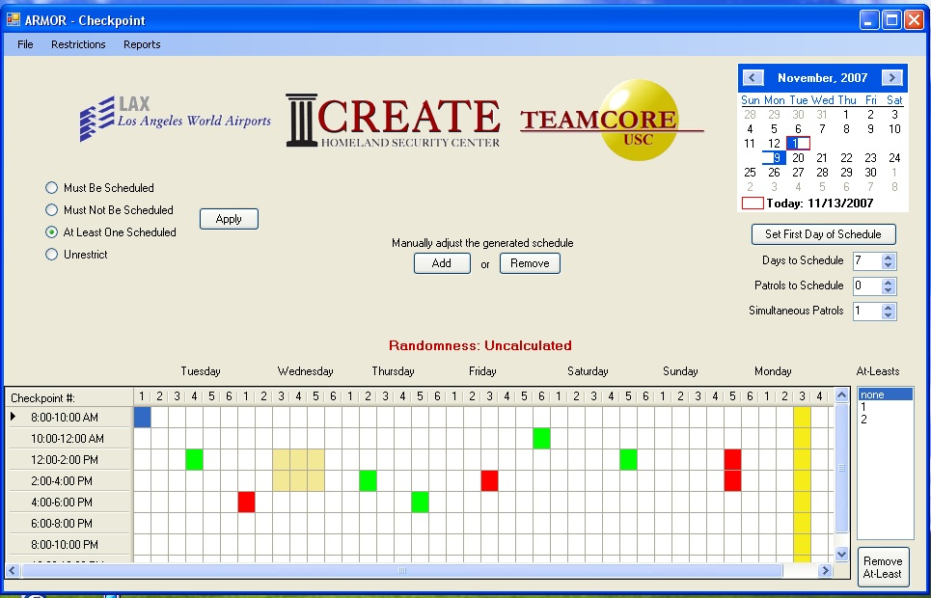

Slide 58
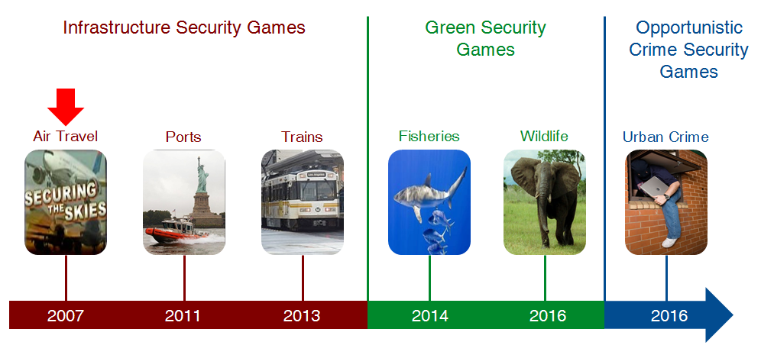
Security Games Status
Game Theoretic underpinnings prevail.
The focus shifted from assuming “classic” rationality to bounded rationality behavior models (e.g., SUQR)

Slide 59
Are attackers really rational?
Not completely.
AMT workers – Expected.
BUT – even security experts don’t play according to the Stakelberg equilibrium.
Nguyen et al. Analyzing the Effectiveness of Adversary Modeling in Security Games, 2013

Slide 60
Quantal Response
    Perfect Response:
    Quantal Response(QR) [McFadden 73]: Stochastic Choice, Better Choice More likely
Adversary’s
probability of
choosing target j

Slide 61
Best Response
Quantal Response
Probability of Action
Probability of Action
$1.01 $1 $0.25
$1.01 $1 $0.25
Expected Payoff
Expected Payoff
Best response: Maximum utility action is always played
Quantal (“softmax”) response: High-utility actions played often, low-utility actions played rarely

Slide 62
Different values of λ

Slide 63
One step further
    Subjective Utility Quantal Response(SUQR) [Nguyen 13]:
Adversary’s
probability of
choosing target j

Slide 64
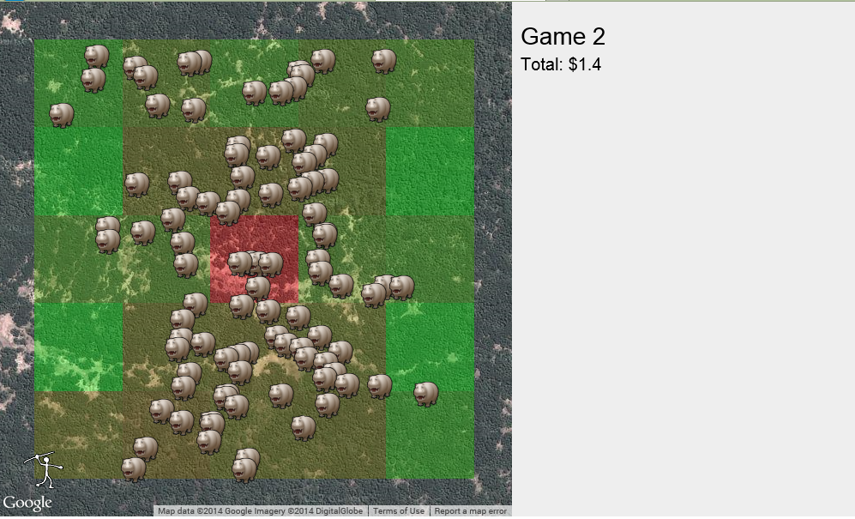
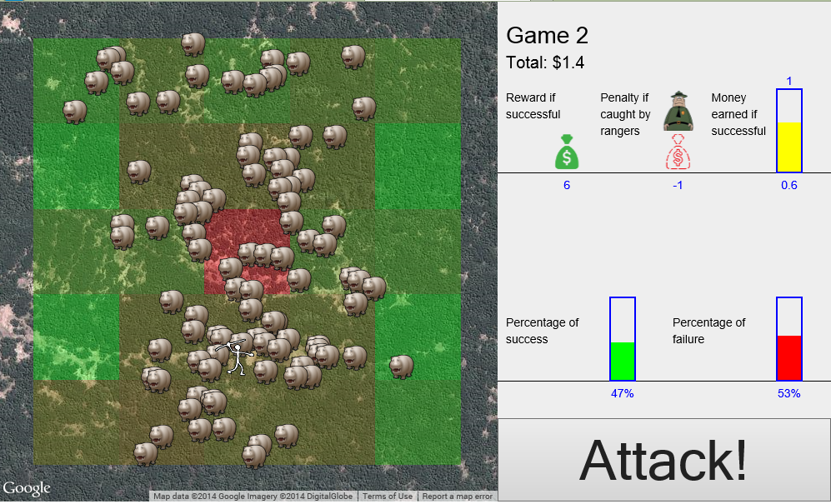
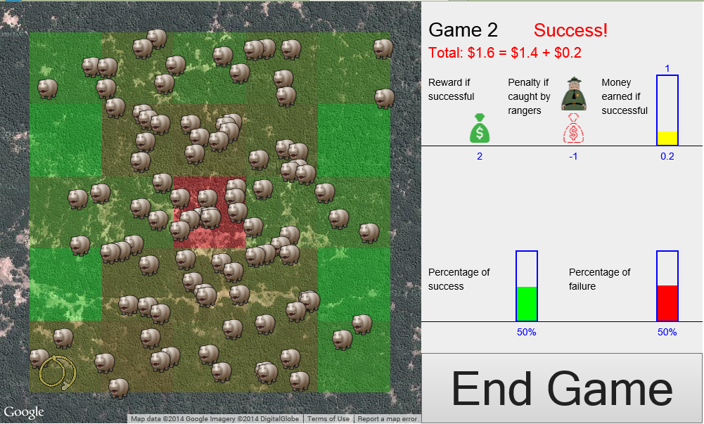
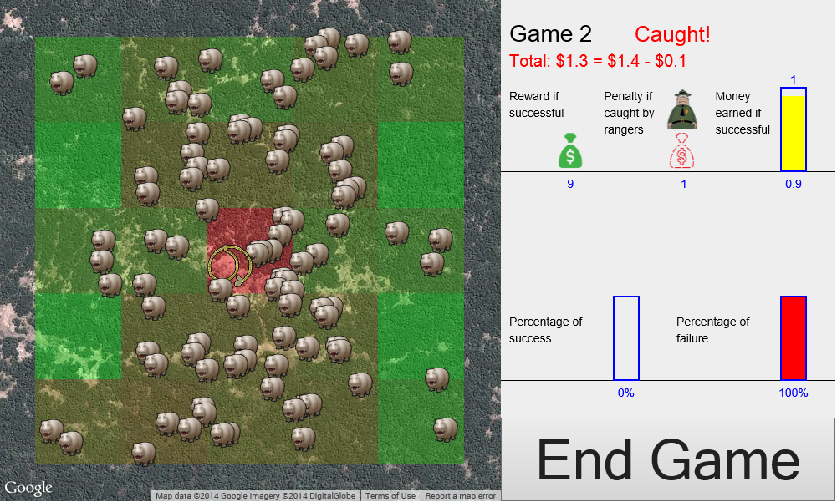
Bounded rationality of poachers

Slide 65
Repeated games [Kar, 2015]
Repeated games on AMT:
35 weeks, 40 human subjects
10,000 emails!
Learn from crime data
Poachers attack targets
Defender calculates strategy
Execute randomized patrols
Maximin
SUQR
Bayesian SUQR
SHARP

Slide 66


WHY DOES GAME THEORY PERFORM BETTER HERE?
Weaknesses of Previous Methods
Human Schedulers
Predictable patterns, e.g., LAX, US Coast Guard
Scheduling efforts and cognitive burden
Simple random (e.g., dice roll):
Repeatedly fails in deployments, e.g., officers to sparsely crowded terminals
Trillions of patrolling strategies, selecting important ones?
Incorporating learned adversary models, planning?

Slide 67
Negotiations
Partial success for GT

Slide 68
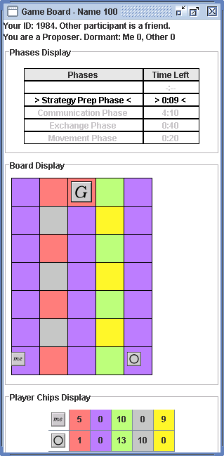
CT Game
100 point bonus for
getting to goal
10 point bonus for each chip left at end of game
Agreement are not enforceable
Collaborators: Gal, Haim, Gelfand
68
Notes:
if I

Slide 69
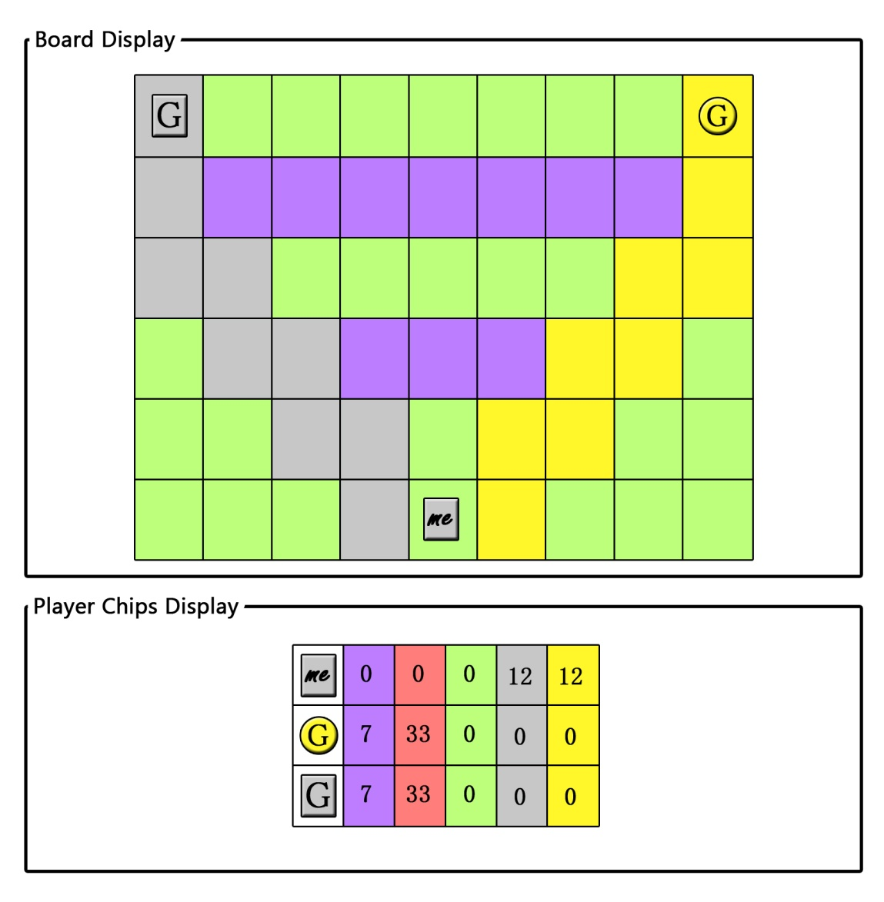
The Contract Game
Main parts:
  negotiation
  movement
Incomplete information
Automatically exchange
Game ends:
  The CS reached one of the SPs
  Did not move for two
  consecutive rounds
Collaborators: Gal, Haim, An

Slide 70



Negotiation
Odd Rounds ➔
Accept/Reject????
To which SP to propose???
Which proposal to propose???
⬅ Even Rounds

Slide 71
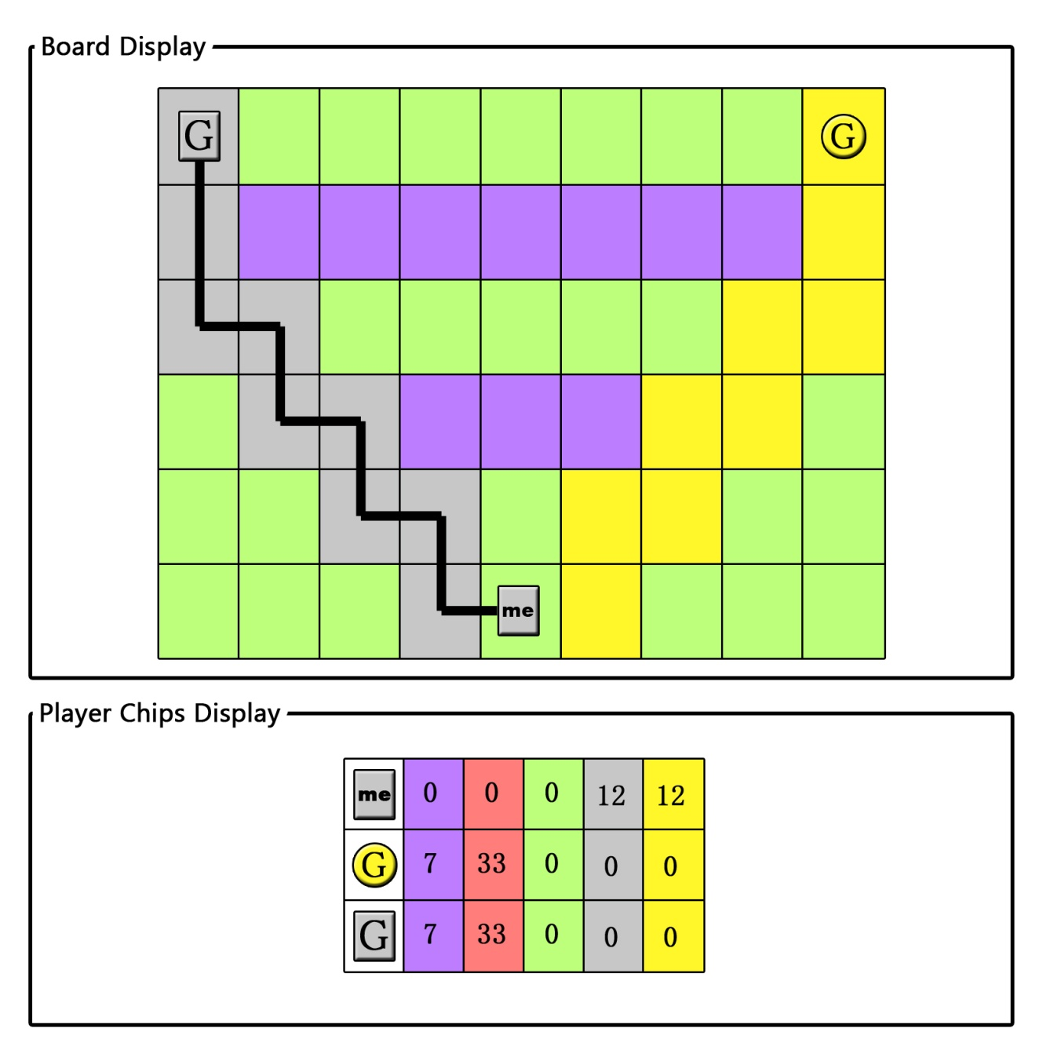
Movement
150 points bonus:
both the CS and the SPg
5 points: for each chip left
Only the CS can move
Chip with the same square-color
Visible movements
Path to goal
More than one square

Slide 72
The Challenge:
Building an Agent that Can Play One of the Roles with People
Sub-Game Perfect Equilibrium
Machine Learning + Human Behavior

Slide 73

Sub-Game-Perfect-Equilibrium Agent
Commitment offer: bind the customer to one of the SP for the duration of the game
Example:
CS proposes 11 grays for
33 red and 7 purple chips

Slide 74

Extensive Empirical Study:
Israel, U.S.A and China
530 students:
  Israel: 238 students
  U.S.A: 149 students
  China: 143 students
Baseline: 3 human players
One agent vs 2 human players
Lab conditions
Instructions in the local language:
  Hebrew, English and Chinese

Slide 75
EQ CS Player’s Performance

Slide 76
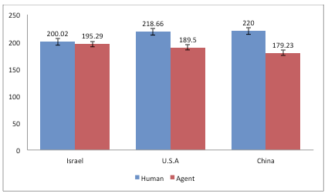
EQ SPy Player’s Performance

Slide 77
Human are Bounded Rational:
Do not Reach the Goal

Slide 78
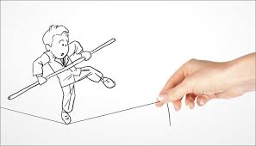
SPy EQ Agent Improvement
Assumption
– When a human player attempt to go to the goal, there is some probability p that he will fail
Risk-Averse Agent
– With respect to probability failure

Slide 79
Risk Averse Agent Results

Slide 80



Fishing Dispute
Multi-issue Negotiation
Outcomes
TAC Limit Season Opt Out Status Quo
World State Parameters
Canada subsidizes Spain reduces Canada imposes Spain imposes ships Pollution Trade Sanctions Trade Sanctions
Hoz-Weiss, Wilkenfeld, Andersen, Pate

Slide 81
Any Player gives an offer
Alternating offers negotiation model
Other Player respond
One rejects, one opts All accept
no one opts out
Negotiation moves END END
to next time period Conflicting Offer Implemented
outcome results

Slide 82
The Automated Negotiator Agent
The agent plays the role of one of the countries.
During the negotiation the agent
  receives messages,
  analyzes them
  responds.
  It also initiates a discussion on one or more parameters of the agreement.
It takes actions when needed.

Slide 83
EQ Agent
Formal strategic negotiation theory:
The agent is based on the a bargaining model. By backward induction the agent builds the strategy to be reached at each time period according to the sequential equilibrium
The agent played very badly against humans
Heuristics

Slide 84
Heuristics
Agreements – may agree to worse agreements than in EQ.
Concession strategy.
Opting out—estimates if the opponent will opt out and may opt out.
Full offers/partial offers; First offer?

Slide 85
Experiments Results

Slide 86
Fishing Dispute: Conclusions
EQ agents does not work.
Our EQH agent played well and fair against a human player.
It raised the sum of the utilities in the simulation it was involved in.
The agent played as Spain significantly better than a human did, and just as good as a human Canada player.
Submitted to AIJ in 2002; revised and accepted 2007

Slide 87
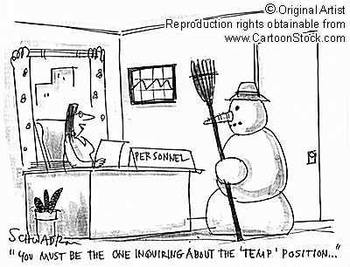
Multi-issue negotiation (cont)
Employer and job candidate
  Objective: reach an agreement over hiring terms after successful interview
  Subjects could identify with this scenario

Slide 88
Nego-Chat
Movie - Nego-Chat

Slide 89
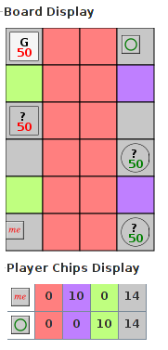
Revelation games
Combine two types of interaction
Signaling games (Spence 1974)
  Players choose whether to convey private information to each other
Bargaining games (Osborne and Rubinstein 1999)
  Players engage in finite horizon
  multiple negotiation rounds
Example: Job interview
Noam Peled; Kobi Gal

Slide 90
Perfect Equilibrium (PE) Agent
Solved using Backward induction.
No signaling.
Counter-proposal round (selfish):
  Second proposer: Find the most beneficial proposal while the responder benefit remains positive.
  Second responder: Accepts any proposal which gives it a positive benefit.

Slide 91
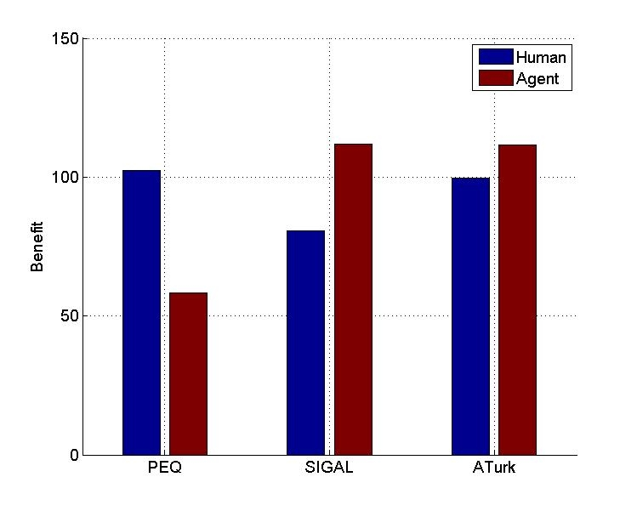
Performance of PEQ agent
130 subjects

Slide 92
SIGAL Agent
Learns from previous games of other people.
Predict the acceptance probability for each proposal using Logistic Regression.
Models human as using a weighted utility function of:
  Humans benefit
  Benefits difference
  Revelation decision
  Benefits in previous round

Slide 93
Performance
General opponent* modeling improves agent negotiations

Slide 94
Negotiation Agents Status
Interleaving bargaining and actions in CT: sometimes EQ agents are beneficial; usually general opponent modeling+ optimization works
Multi-issue negotiation: general opponent modeling+ Optimization

Slide 95


Virtual Suspect to Train Investigators

Slide 96
Psychologically-Based Virtual-Suspect
Virtual-Suspect Training system.
Interrogator's statement affects the psychological state.
Responses are selected based on psychological state.
Moshe Bitan, Galit Nahari, Zvi Nisin, Ariel Roth, Sarit Kraus. Psychologically based Virtual-Suspect For interogative Interview Training, AAAI 2017

Slide 97

Comparing the system with a human instructor.
VRSM behavior is similar to that of a human who plays t
he role of the suspect

Slide 98
Heuristics
A lot of examples from Economical settings (not only..)
There are several well-known (and well-studied) cognitive biases of human buyers (e.g., anchoring effect, Bandwagon Effect, etc.)
Capitalizing on these human biases combined with economical search theory for selecting when and which information to disclose and what price to set

Slide 99



Online Shopping
Display prices sequentially, adding some delay between any two prices.
Anchoring
Ordering
etc.
Hajaj et al. Enhancing comparison shopping agents through ordering and gradual information disclosure, JAAMAS 2017.
Sarne et al. Improving Comparison Shopping Agents’ Competence through
Selective Price Disclosure, Electronic Commerce Research and Applications 2015.

Slide 100

Rational Voters
What is “rational” in voting?
Voters do not know the preferences of others
Voters cannot collaborate with others
Thus, improvement steps are myopic, or local (with respect to polls for example) .

Slide 101
Strategic Voting
Simple heuristics can predict people’s voting behavior.
  E.g., Change vote to one of the 2 leading options.
“Pure Rational” voting is not common.
Tal et al. A Study of Human Behavior in Online Voting, AAMAS 2015

Slide 102
Descriptive Predication
"The best predictor of future behavior is … past behavior"

Slide 103
Recall that…
Experimental studies of choice behavior document distinct, and sometimes contradictory, deviations from maximization.
Could those deviations be predicted using machine learning?

Slide 104
Statistical
High-frequency, habitual behaviors are more predictive than infrequent behaviors.
Predictions work best over short time intervals.
The anticipated situation must be similar to the past situation that activated the behavior.
The behavior must not have been extinguished by corrective or negative feedback.
The person must remain essentially unchanged.
The person must be fairly consistent in his or her behaviors.
Modeling and Understanding Human Routine Behavior, Banovic et al. (2016)

Slide 105
Nevertheless…
Icek Ajzen found that a student's attendance rate for the first eight sessions correlated 0.46 with his or her attendance rate for the second eight sessions.
All the conditions are in place: Class attendance is a habitual and routinized behavior, the prediction span is very short, and there is little likelihood of meaningful changes in either the situation or the person. Yet, the correlation is far from perfect...
Ajzen, Icek. Attitudes, personality, and behavior. McGraw-Hill Education (UK), 2005.‏

Slide 106
Approaches Part 1
Personalized
Clustering
Generalized Model
Complex
Better?

Slide 107
Approaches Part 2
Particular Setting
Set of Circumstances
Holistic Model
Easier
Better?

Slide 108
Temporal Aspects
One shot
Repeated
Continuous

Slide 109
Setting
Supervised
Unsupervised
Semi-Supervised
RL

Slide 110

But… It’s (supposed to be) easy!
Deep networks should answer all our prayers!
Deep learning has demonstrated the possibility of
stunning predictive performance via learning features
Could we automatically search for behavioral models?

Slide 111


Rock
Paper
Scissors
Target distribution
Rock
0, 0
-1, 1
2, -2
R
1, -1
0, 0
-1, 1
P
Paper
P
-2, 2
-1, 1
0, 0
S
Scissors
S
Deep Learning for Human Strategic Modeling.
Jason Hartford, James R. Wright, and Kevin Leyton-Brown, NIPS 2016

Slide 112
Architecture* achieves state-of-the-art performance
predicting human behavior in normal form games
But.. 2 problems.
* Deep Learning for Human Strategic Modeling.
Jason Hartford, James R. Wright, and Kevin Leyton-Brown, NIPS 2016
Notes:
If you'd like further details, come chat to us at our poster session.

Slide 113
Prob. 1 - Deep Learning is an art
Not a “one-size-fits-all” solution
A lot of tricks.
Glorot, Xavier, and Yoshua Bengio. "Understanding the difficulty of training deep feedforward neural networks." Aistats. Vol. 9. 2010.‏
Bengio, Yoshua. "Practical recommendations for gradient-based training of deep architectures." Neural networks: Tricks of the trade. Springer Berlin Heidelberg, 2012. 437-478.‏

Slide 114


Prob. 2 - Where is big data coming from?
Passive collection:
  posts to social media sites
  digital pictures and videos
  GPS trails
  Transaction records
  cell phones
  traffic.
  Etc.

Slide 115












Computerized Agents that Interact with People: collecting data is tremendous work
Supporting Teams of Robots & Operator
Persuading people
to save energy
Training people in
negotiations
Virtual suspect for training investigators
Culture sensitive
negotiation agent
Agent supports Argumentation
Automated Speech Therapist
Automated
mediators

Slide 116
Task and Goal Oriented Data
Collection is Difficult
Need to create the situation for the collection of relevant data.
For human-agent interaction, the behavior of the agent may change the human’s behavior.
Choosing the right incentives.
Abstraction or real situation?
Avoid confirmation Bias
Etc…
People keep ruining our experiments…

Slide 117

Supervised learning
Decision tree
Perceptron
Artificial neural network
Bayesian approach
Genetic Algorithms
Etc.
Notes:
CF היא הראשונה שהיתה. באמזון ונטפליקס היו הראשונים שהשתמשו בדאטא כדי למכור.

Slide 118
Decision Tree for PlayTennis
Outlook
Sunny
Overcast
Rain
Humidity
Each internal node tests an attribute
High
Normal
Each branch corresponds to an
attribute value node
No
Yes
Each leaf node assigns a classification

Slide 119
Top-Down Induction of Decision Trees ID3
A ← the “best” decision attribute for next node
Assign A as decision attribute for node
For each value of A create new descendant
Sort training examples to leaf node according to
the attribute value of the branch
If all training examples are perfectly classified (same value of target attribute) stop, else iterate over new leaf nodes.

Slide 120

Perceptrons
(-1, -1)
(1.6, -1.6)
The step function is:
F(x)= 1 if x>2,
0 otherwise

Slide 121
Perceptron Learning Algorithm
Initialize weights and threshold:
Set w_{i}(t), (0 <= i <= n), to be the weight i at time t, and ø to be the threshold value in the output node.
Present input and desired output
Present input x₀, x₁, x₂, ..., x_{n} and desired output d(t). (x₀ is always1).
Calculate the actual output:
y(t) = f_{h}[w₀(t)x₀(t) + w₁(t)x₁(t) + .... + w_{n}(t)x_{n}(t)]
Adapts weights
w_{i}(t+1) = w_{i}(t) + η[d(t) - y(t)]x_{i}(t) , where 0 <= η <= 1 is a positive gain function that controls the adaption rate.
Steps 3 and 4. are repeated until the iteration error is less than a user-specified error threshold or a predetermined number of iterations have been completed.

Slide 122

ANN

Slide 123


Slide 124

The Bayes Classifier
So … How do we compute that?

Slide 125

The Bayes Classifier
Use Bayes Rule!
Why did this help? Well, we think that we might be able to specify how features are “generated” by the class label
Likelihood
Prior
Normalization Constant

Slide 126

The Naïve Bayes Model
The Naïve Bayes Assumption: Assume that all features are independent given the class label Y
Equationally speaking:
(Not realistic, but works… sometimes..)

Slide 127

Evolution in the real world
  Each cell of a living thing contains chromosomes – strings of DNA.
  Each chromosome contains a set of genes – blocks of DNA.
  Each gene determines some aspect of the organism (like eye color).
  Reproduction involves recombination of genes from parents and then small amount of mutations (errors) in copying.
  The fitness of an organism is how much it can
  reproduce before he dies

Slide 128


Slide 129
Examples

Slide 130
Cooperative Agents
No hidden agenda.

Slide 131



Time to Graduate?
I have 6 conference papers and 2 journal papers.
They are great papers, but you can do more.
I guess you are right…
My Advisor
Me

Slide 132

Agent Supports Discussions
Past discussions accumulative data
Current discussions
Update
Agent
Offer arguments
= Obtains information
Notes:
Semantic independent

Slide 133
Predicting human argumentative behavior
Three (Major) options:
  Argumentation theory.
  Heuristics.
  Machine Learning.

Slide 134
In theory…
Construction arguments
Defining the interactions between arguments
Evaluating the strengths of arguments
Defining the status of arguments
Drawing conclusions using a
consequence relation
Comparing decisions using
a given principle
Inference problem
Decision making problem

Slide 135






Argumentation Theory?
Extensions?
Validity values?
Justification value?
People do not reason logically.
There is temporal nature of
argumentation which is not captured.
Dung
Wyner
Reed
Cayrol
Parsons
Giacomin
Notes:
כשהתחלתי את המחקר מאד הייתי נלהב מהתיאוריה, ורציתי לעשות עבודה פורמלית. קראתי המוני מאמרים –
אתם יודעים כמה יש שם.
האמנתי שמהתיאוריה יצאו היכולות לסוכנים, ולצערינו אנשים לא מדיינים כך.
לפני שהתחלתי לבנות את הסוכנים הייתי חכם מספיק לעשות ניסוי וגיליתי שיש בעיה.
הניסוי הראשון היה מלאכותי, ושם אנשים לא דיינו הגיוני. חשבנו שאולי זה בגלל המצבים המלאכותיים.
אז ניסינו בשיחות מתומללות – וגם בהן זה לא עבד, התיאויה הסבירה מעט מאד.
(לא להיכנס לפרטים טכנים – מה בדקנו)
רצינו להשתמש בלמידת מכונה, ורצינו לבדוק האם אפשר לשלב את ארגומנטציה בפרדיקציה
השתמשנו במבנה של המודל – המודל הפורמלי לסוכן
התיאוריה לא עזרה לי להסביר, אבל כן מהווה את הבסיס למודל של הסוכן ולפוליסי. בנוסף השתמשנו בחישובים מתירואיה בפיצרים
להראות את הדוגמא

Slide 136

Argumentation Theory?
Data Collection of 6 fictional Cases
64 participants from Amazon Turk;
  Age average: 38.5
  21 females; 17 males
  3 with Phd

Slide 137

Argumentation Theory?
SUV
Safe
8%
Too expensive
35%
High taxes
Taking out a loan
Taking out a loan
33%
High interest
24%
Arvapally et al, 2012
Notes:
We can take a loan
Loans from the bank has a high interest so it is not a good idea. 0 of the leaves; Take a loan - -0.33

Slide 138



Argumentation Theory?
Transcription of Real Discussions
Penn TreeBank Project (1995) conversation database:
  CAPITAL PUNISHMENT (33)
  TRIAL BY JURY (31)
Less than 30% were justified.
Notes:
15 topics

Slide 139

Predicting Arguments
Given 5 choices of a subject, calculate the average of each feature, and predict the 6th one.
Notes:
72% accuracy if past decisions are available.
Random offers 25% accuracy.
Majority choice provided 42%.
The performance improves as more answers are available.

Slide 140
Culture based?
  78 Computer Science students.
    CS-77% > AMT 72%
  Exactly the same features as AMT.
  Can learn from one and predict to the other.
Notes:
אותם פיצרים

Slide 141
Transcription of Real Discussions
Capital punishment:
  33 examples, AF of 33 nodes
Trial by jury
  31 examples, AF of 26 nodes
All arguments appeared in 4-6 examples
Notes:
חזרנו שוב לתמלול ועשינו את אותו התמרון
בכל הניסויים הפרדישקן הראה שאותם פיצרים יצאו משמעותיים ובמיוחד הרלוונטיות
להדגיש שמ4 שיחות היו כמעט כל הארגומנטים!!!!!

Slide 142

Capital Punishment – Ranking

Slide 143

Online Dating
Predict a reciprocal interaction between users
  A messages B
  AND
  B messages A back.
Recommendation System methods.
“Males tend to be focused on their own interest and oblivious towards their attractiveness to potential dates, while females are more conscientious to their own attractiveness to the other side of the line".
Xia, Peng, et al. "Reciprocal recommendation system for online dating." Advances in Social Networks Analysis and Mining 2015. ACM, 2015.‏

Slide 144
Rehabilitation Agents

Slide 145


Automated Speech Therapist

Slide 146
Adversary agents

Slide 147
Games
Predicting what strategy is most likely to explain the user’s move(s).
Current work on predicting people’s actions in partial information games.
Brown, Rebecca, and Curry Guinn. "Developing game-playing agents that adapt to user strategies: A case study." IEEE Symposium on Intelligent Agents (IA), 2014.‏

Slide 148











Fraud Detection
Features such as:
Dollar Amount
Platform
New device
Payee characteristics
Deny
ML
Challenge
Risk Score
Review
Allow
Fawcett, Tom, and Foster Provost. "Adaptive fraud detection." Data mining and knowledge discovery 1.3 (1997): 291-316.‏
Phua, Clifton, et al. "A comprehensive survey of data mining-based fraud detection research." arXiv preprint arXiv:1009.6119 (2010).‏

Slide 149

Insider threat
Among the most pressing cyber-security challenges.
Threaten government/private-sector information infrastructures.
To this day no systematic method was made to find and prevent such acts in effective way.
Kandias, Miltiadis, et al. "An insider threat prediction model." International Conference on Trust, Privacy and Security in Digital Business. Springer Berlin Heidelberg, 2010.‏

Slide 150



Some history…
Benedict Arnold.
Defected to the British army(1780),
After he was passed over for promotion by the continental congress.
Aldrich Ames.
Rising star in the CIA.
Became a KGB mole due to drinking and security problems.
Convicted in 1994
Bradley Manning.
Convicted 2013 of violations of the Espionage Act.
Disclosed to WikiLeaks nearly three-quarters of a million military and diplomatic documents.

Slide 151



Slide 152
Human Strategic Behaviour in Normal form games
Movie - Deep learning for Human Strategic Behaviour.
Deep Learning for Predicting Human Strategic Behavior. J. Hartford, J. Wright, K. Leyton-Brown. Oral presentation at Conference on Neural Information Processing Systems (NIPS), 2016

Slide 153
Altruism prediction
1,067 Mechanical Turk workers X 20 decisions = 21,340 decision total
 | Selfish option | Cooperative Option
Participant Payoff | x | x-c
Recipient Payoff | y | y+c*f
Ziv Epstein, Alex Peysakhovich and Dave Rand. The Good, the Bad, and the Unflinchingly Selfish: Cooperative Decision-Making can be Predicted with high Accuracy when using only Three Behavioral Types, 2016
Notes:
C = caputre individual cost
F = pie
Remind of what features are
Game parameters:
Individual level features :
Quadrartc + interactions

Slide 154





Model Building
Capturing individual cooperation history leads to much higher predictive power
Model using 3 cooperative types yields approximately same predictive power as fully heterogeneous model.
Notes:
Next we looked at a two type model, cooperators and non-cooperators. Do this by counting number of times each participant cooped in the training set.
Capturing individual level history is necessary for good out-of-sample prediction
3-type model is almost as powerful as fully heterogenous

Slide 155



What are the three groups?
most cooperative
they cooperated in 6 or more of their 15 training decisions
intermediately cooperative
they cooperated at in at least 1 to 6 of their 15 training observations
least cooperative
they cooperated in none of their 15 training observations
Attempted to predict cooperative type from these demographics.
Maximum AUC achieved was 0.54. Not very good!
Suggests cooperativeness is orthogonal to other demographics and is a natural kind (i.e. the cooperative phenotype)
Notes:
After reveal 3 types, talk about why demographics is important, dont want to be the derpy psychologist

Slide 156
Combining Psychological Models
Incorporating psychological models and data science in service of predicting human behavior.
Aspiration Level
Anchoring Bias
Availability Heuristic
Etc.
Noti, Gali, et al. "Behavior-Based Machine-Learning: A Hybrid Approach for Predicting Human Decision Making." arXiv preprint arXiv:1611.10228 (2016).‏
Rosenfeld, Avi, et al. "Combining psychological models with machine learning to better predict people’s decisions." Synthese 189.1 (2012): 81-93.‏

Slide 157
Combining Behvaioral Science in ML
Nature
x
y
Prediction: Find f(∙) such that f(x)≈y
  Machine learning people are the experts on this!
What is x?
  Behavioral scientists are many times the experts on this!

Slide 158
Example for trials 6-25:
Example for trials 1-5:
Please choose ‘A’ or ‘B’:
B: 4 with probability 0.8 0 with probability 0.2 |  | A: 3 with certainty
A
B
3
4
You selected ‘A’, and your payoff is 3
Had you selected ‘B’, your payoff would have been 4
You selected ‘A’
Erev et al. From anomalies to forecasts: Toward a descriptive model of decisions under risk, under ambiguity, and from experience, Psychological Review, 2017

Slide 159
What is x?
“Objective” features
  11 parameters Defining the choice problem
“Naïve features”
  Difference in EVs, Difference in SDs…
“Psychological features”:
  Pessimism:
  diffMins = Min_{B} – Min_{A}
  = minimal outcome of B – minimal outcome of A
  Minimization of regret:
  pB_better = P[F_{B}⁻¹(x) > F_{A}⁻¹(x)] - P[F_{A}⁻¹(x) > F_{B}⁻¹(x)]
    = P[B providing better outcome than A] – P[A providing better outcome than B]
Plonsky et al., Psychological Forest: Predicting Human Behavior, AAAI 2017

Slide 160
Plonsky et al., Psychological Forest: Predicting Human Behavior, AAAI 2017

Slide 161

Prediction Models In Practice
“All models are wrong.
Some are useful.”
-George Box
How “useful” are these models? How would you even measure that?
Key insight: USEABILITY.
Notes:
A model is as good as it can predict novel data

Slide 162
Agent design
  Data on human behavior
  Environment data
Machine Learning
Human model
Optimization
Environment model
Action
Notes:
Our agent uses 2 main moduls. The first; an operator model quatifing the operator's abilities, the second - a robot model quantifying the robots effectivness. Both are estimated in terms of time. As I will describe next, both models were trained empirically using machine learning techniuqes. The two models are then integrated into an optimization problem that it's solution provides the best advice according to the current state of the enviorment and the 2 models.
Keep in mind, that the agent and the operator share the same goal, of finding as many desiered objects as possible. In our setting, these objects were green Objects that the human-robots team had to identify and correctly classify. The agent can utilize its computational advantage over the operator and provide contextual advice that the operator is likely to follow.

Slide 163

From Prediction to Action

Slide 164

Argumentation Recommendation Policies
How can we assist a human while arguing?
  No pro-active approach.
Should we suggest the predicted arguments?
How to maintain a good hit-rate while offering novel arguments?
Notes:
האם מה שלמדנו על הפיצרים ועל הפרדקציה, האם זה יכול לעזור לנו לתת הצעות

Slide 165

Agents
PRD: Prediction [17 chats]
REL: Relevant [17 chats]
WRL: Weakly related [17 chats]
PRH: Prediction (2) + Relevant (1) [17 chats]
TRY: Theory [17 chats]
REP: PRH with repeated arguments [17 chats]
TLA: TL agent [17 chats]
RND: Random [17 chats]

Slide 166
Normalized Acceptance Rate
Notes:
הבדל לא סגניפיקנט בין פרדיקציה+קרוב לעומת רק קרוב

Slide 167
User Satisfaction
V. Positive | Positive | Neutral | Agent
2 | 10 | 5 | Prediction
0 | 12 | 5 | Relevant
0 | 1 | 16 | Weakly related
5 | 12 | 0 | Prediction + Relevant
1 | 3 | 13 | Theory
0 | 3 | 14 | Random
0 | 5 | 12 | Repeated
1 | 3 | 13 | TLA

Slide 168



Partially Conflicting Interests
Driver’s and system’s goals are partially conflicting.
I’m Hot!
Let’s minimize energy consumption...
Rosenfeld et al. Adaptive Advice in Automobile Climate Control Systems, AAMAS 2015
Notes:
We have the driver on one side of the interaction, and he is mainly considered with its own comfort rather than the car's energy consumption.
Most of us don't even know how much energy our CCS even consumes..
The agent's goal on the other hand is to reduce energy consumption.
There is an inherent conflict here, which needs to be bridged -- our approach does it using advice.
This partial conflict makes it extremmly difficult to choose when and which settings to advice the driver.
Considering only one of the parties goals is not expected to provide good results.. Very consuming vs. turning it off.
This framework is not restricted to CCSs, and is very common in automotive systems – for example, ACC and autonomus driving.. the driver mainly cares about arriving fast and the agent mainly considers the drivers safty.

Slide 169

Agent
Advice
Controls
Effects
Effects
Effects
Goal: minimize the accumulative energy consumption.
Rosenfeld et al. Adaptive Advice in Automobile Climate Control Systems, AAMAS 2015
Notes:
So we have a driver and a CCS system. The driver controls the CCS system and in turn, the CCS effects the drivers comfort.
Also we have the enviorment, which represents the car's internal conditions and external tempreture, affect both the feriver and the system. For example, when the car is extremmly hot, as we examined in this work, the driver is uncomfatable and the CCS has to work harder to provide the requested T and F.
Our agent interacted soley with the driver and provides suggestions as to how to set the CCS.
And keep in mind, that it's goal is minimizing energy consumption.

Slide 170

Evaluation
45 drivers - 15 per condition, 3 rounds.
KWH
The lower the better.
Notes:
Using another 45 subjects, again – not a simple task, and the same exhaustive procude from the data collection phase we evaluated our agents.
We used a between-subjects experimental design were 15 subjects took part in each condition, equipped with the MDP agent, SAP agent, and a silent agent that does not provide any advice.
All subjects experienced extremely similar external condition. The experiments were conducted in the course of 3 week in augoust las year, which is quite hot – between 35 and37 degrees. They property is essential for maintaining the secentific integrity of our between-subjects experimental design.
As you can see, we have a significant imporvment in energy consumption for subjects equipped with MACS. Those sbjects saved 33% compared to a benchmark group who did not recive any advice at all.
SAP did decress 5%, yet this difference was not significant.
This result was supprising, esspicially after we've seen that SAP outperformed MDP in a simulated CCS envioremnt in a privous study. However, in the mentioned work, the utilities were given and known to both parties of the interaction, which is unrealistic in real-world implementation.

Slide 171
CT Game
100 point bonus for
getting to goal
10 point bonus for each chip left at end of game
Agreement are not enforceable
Collaborators: Gal, Haim, Gelfand
171
Notes:
if I

Slide 172
Interleaving Negotiations and actions: Color Trails (CT)
An infrastructure
for agent design,
implementation
and evaluation for open
environments
Designed with Barbara
Grosz (AAMAS 2004)

Slide 173

An Influence Diagram-
Two rounds interaction
Probability of acceptance
Probability of transfer
Notes:
Decisions for PAL are represented by decision nodes (gray rectangles).
Dashed edges represent information that is used to update the state at each round.

Slide 174
Stefano V. Albrecht: predicting the type of the opponent

Slide 180
Persuasion using POMDP

Slide 181

Persuasive Dialog Optimization
The persuader presents arguments to influence the persuadee.
  Maximize\Minimize the evaluation of $ω$
Each persudee may use a different argumentation framework.
  The persudee uses an unknown argumentation framework.
  How can we know?
Presuadee Arguments serve as signals.

Slide 182

POMDP
States – Argumentation framework
Observation – dialog
Actions - arguments
Transition – Prediction
Reward – v$aluation of ω$
Discounting factor – avoiding long (useless) dialogs
Approximated using Monte-Carlo simulations.

Slide 183
Experimental Setting
  Strategic Persuasion Agent (SPA)
  Baseline
Human
Chocolate cake vs. energy bar – Binary practical decision.
Computer Science Master’s Degree – Attitude (1-5 scale).

Slide 184
Evaluation
Computer Science Master’s Degree
Chocolate cake vs. energy bar
Changed opinion | Subjects | Agent
26.6% (4) | 15 | SPA
6.6% (1) | 15 | Baseline
26.7% (15) | 56 | Human
Changed opinion | Subjects | Agent
26.6% (4) | 15 | SPA
0% (0) | 15 | Baseline
10.7% (3) | 28 | Human

Slide 185
Robotics
Predicting human capabilities for assisting human-multirobot collaboration.
Movie.
(Best robotics video IJCAI 2015).
Rosenfeld et al. Intelligent Agent Supporting Human-Multi-Robot Team Collaboration, IJCAI 2015

Slide 186
Human behavior for driving ML advancements
It’s not a one-way street!

Slide 187



Cooling a car’s interior
Summer is Hot (+30C in the summer).
35C
20C
15C
Rosenfeld et al. Online Prediction of Exponential Decay Time Series with Human-Agent Application, ECAI 2016

Slide 188

Cooling a car’s interior
Drivers’ preferred cabin temperature
is assumed to exponentialy decay.
We recruited 28 subjects. (not that easy!)
  Each subject had to cool the car as she sees fit twice,
  simulating 2 different trips.
  Leave one out test.

Slide 189

Evaluation
Within subjects experimental design, 24 drivers.
Extremely hot environment(~35C)
Automated CCS vs. State-of-the-art CCS.
Reduced average number of interactions (5.3 vs. 6.6)
High satisfaction (7.2 vs. 6.2).
Notes:
Overall, in both setting, our agent was able to perform on a human-like
level and significantly better than a baseline agent.
In the Master’s degree domain our agent was capable to convice 4 out of 15 subbjects… whereas the baseline was secsessful with only 1 subject.
In the second, our agent…
In both settings our agent is not significantly outperomed by the human-level persuasion.

Slide 190




Predicting Decisions of Taxi Drivers for Improving Revenues
Annotate the trajectory data with the decision taken by cruising taxi drivers such as wait at current zone, move to some other zone.
Define state space (spatio-temporal location of taxi) and action space (stay in same zone, change zone).
Use annotated data to kick start optimization.
Tanvi Verma, Pradeep Varakantham, Sarit Kraus and Hoong Chuin Lau
In Proceedings of the International Conference on Automated Planning and Scheduling, ICAPS-17.
Notes:
What is the best action to take for maximizing long term revenue generation?
A taxi is said to be cruising when there is no passenger onboard and the driver is actively seeking passenger, whether roaming around or resting at a location.
Can we learn good policies from decisions taken by cruising taxi drivers?

Slide 191


Use the prediction to determine Q-values and optimize.
Average revenue earned by learned policy is better than the top 10 percentile revenue among all the drivers.
Notes:
The plots compare revenue earned by learned policies for static abstraction and dynamic abstraction methods for different day of the week and time of the day.
The comparison is against top 500 drivers for the selected day
Learned policy perform much better during early hours. During early morning hours, demand is sparse and scattered. Unless the taxi driver is in the right place, they would not make revenue. RL approach is able to identify the right patterns from past data to recommend good locations to taxi drivers for early morning hours. On the other hand, during peak hours, demand is high, so taxis can easily find customers in most zones.
We also show that taxi utilization is also high. Utilization rate for a time interval is computed as percentage of time the agent/driver is occupied during the time-interval.

Slide 192
Conclusions
What should I do?

Slide 193
Step 1
“Take a social science crash course”
Form a firm grasp on what makes YOUR people tick, it may not always be what you’d expect.
The Important Questions:
  Which assumptions were made\validated by pervious works in the realm?
  Did you check behavioral sciences for answers?

Slide 194
Step 2
“In DATA we trust”.
  Collect contextual data (it might take more effort than you’d think!)
The Important Questions:
    Which is the appropriate data collection method?
    Is the data reliable and extensive?
    Did you examine the ecological validity of YOUR assumptions?

Slide 195
Step 3
“Put on your lab coat”.
Carefully use machine learning to detect the underlying procedures that produced the collected.
The Important Questions:
    Which machine learning procedures are appropriate to the collected data?
    Did you account for statistical factors such as minority cases, time series effects, outliers, etc.?
    Did you make sure you avoid overfitting?

Slide 196
Step 4
“Don’t stop ‘till you get enough”
Enhance your prediction model

Slide 197
Step 5
“Mix it up”
Integrate the prediction model into your system’s design.
  Optimization.

Slide 198

Challenge 1
The lack of good theoretical foundation for human-agent interactions yields the need to start each application from scratch
Can we do better?

Slide 199

Challenge 2
Obtaining reliable data.
  Is smartphone \ wearable devices the answer?
Rischan Mafrur, I. Gde Dharma Nugraha and Deokjai Choi, Modeling and discovering human behavior from smartphone sensing life‑log data for identification purpose, 2016.

Slide 200
Challenge 3
Explaining Human DM prediction
Explanations that are too complex might actually negatively affect acceptance of a system.
Also good explanations can hinder the acceptance of individual recommendations
Algorithmic Transparency via Quantitative Input Influence: Theory and Experiments with Learning Systems, IEEE Symposium on Security and Privacy, 2016

Slide 201
Challenge 4
The integration of human models to ML techniques.
Human models are currently evaluated using ML*, but their integration is still underdeveloped.
* A. Peysakhovich and J. Naecker. Using methods from machine learning to evaluate models of human choice. 2015.

Slide 202
Take home message
Predicting Human Decision Making an behavior is Hard.
  Don’t expect to reach 90%...
  Normative Models can help.
  Machine Learning is very useful.
Human Prediction drives developments in other fields
  Software Architectures
  Machine Learning
Enhancing Human Interaction with Software\Robots…
Training People
Replacing People
Supporting People
Etc.
Notes:
The work presented here is part of our ongoing effort to investigate the connections and challenges between Argumentation Theory and people.
Besides presenting our approch, I hope that the encouraging results presented here and in our priovous publications on the topic which are specified here - will encourge other researchers to investigate
other argumentative propertise in human experiments.
So I think that the take home messege from this talk is, we need to examine our ideas with people to ensure the ecological validity of our ideas.

Slide 203

Thanks
Ariel Rosenfeld:
arielros1@gmail.com
Sarit Kraus
sarit@macs.biu.ac.il
https://sites.google.com/view/predicting-human-dm
http://tinyurl.com/predicting-human-DM
Notes:
Thanks

Slide 204


